Slide 1
Essential C Security 101
Offensive Computer Security
Florida State University
Spring 2014

Slide 2
Outline of talk
Intro to CPU & Registers
Motivation
Strings
Pointers
Dynamic Memory Management

Slide 3
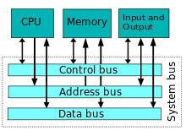
Von Neumann Architecture

Slide 4
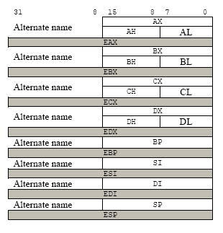
Registers (General Purpose)
EAX - Accumulator
holds return value usually
EBX - Accumulator
base
ECX - Count & Accumulator
EDX - Data or I/O Address pointer
ESI - Source index
for source of string / array operands
EDI - Destination index
for dest of string / array operands

Slide 5
Registers (Important Ones)
EIP - Instruction Pointer
(Points to Next instruction to be executed)
Want to hijack during exploitation
ESP
Stack pointer
EBP
Stack base pointer

Slide 6
Tool we will be using
http://gcc.godbolt.org/
A project that visualizes C/C++ to Assembly for you. (use g++ compiler, intel syntax, and no options)
Quite useful for learning this stuff (also interesting: https://github.com/ynh/cpp-to-assembly)

Slide 7
Lecture Source Material
[1] Seacord, Robert C. “Secure Coding in C and C++”. Second Edition. Addison Wesley. April 12, 2013
(not required, but highly recommended)

Slide 8
Motivation
One of the most widely used programming languages of all time
Want to use a different language?
It’s backend is likely written in C!
Python
Ruby
Java!
Vast majority of popular languages borrow from it

Slide 9
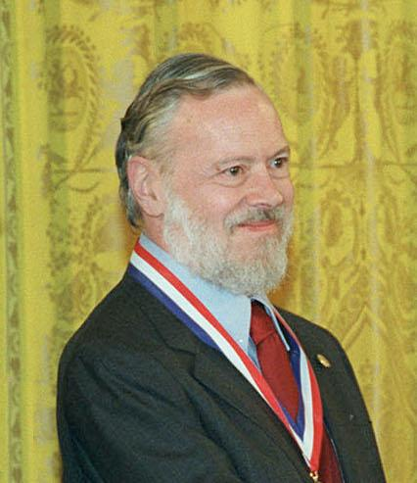
About C
Dennis Ritchie at ATT Labs
Standards:
ANSI C89 (American National Standards Institute -- no longer around)
ISO C90 (Int’l Org for Standarization)
ISO C99
ISO C11 (December 2011)
Dennis Ritchie died October 2011 Way cooler than Steve Jobs...
TURING AWARD == BOSS

Slide 10
CCCCCCCCCCCCCCCCCCCC\xCC
USED IN EVERYTHING!
45 years and going strong!
Operating Systems
Embedded Systems
Planes, Trains, Satellites, Missiles, Boats, etc..
Drivers, Libraries, Other languages...
You just cannot get away from it.

Slide 11
Strings
String Types
String functions
Common Errors / Vulnerabilities
Mitigations

Slide 12
Some C Terms for strings
String - sequence (array) of characters up to and including the null character terminating it
Length - the length of the sequence up till (not counting) the null character
Size - number of bytes allocated to the array
Count - number of elements in the array
size != length (depends on character size)

Slide 13
Length of Character / String
Atomic size (# bytes) of string depends on length of character!
A single UTF-8 char = 1-4 bytes
wide char = 2-4 bytes
Strings can be:
normal / “narrow”
wide character
multi-byte (heterogenous char types!)

Slide 14
Characters
char types:
char
unsigned char
signed char
wchar_t types:
wchar_t
unsigned wchar_t
signed wchar_t
In general wchar_t is not meant to be signed / unsigned.
whcar_t is a integer type whose range of values can represent distinct codes for all members of the largest extended character set specified among the supported locales [1]

Slide 15
Examining characters
#include <string.h>
void foo()
{
size_t len;
char x;
signed wchar_t y;
unsigned char z;
signed char zz;
len = sizeof(x);
len = sizeof(y);
len = sizeof(z);
len = sizeof(zz);
}

Slide 16
wchar_t
Windows typically uses UTF-16
wchar_t is thus 2 bytes (16 bits…)
Linux / OSX typically uses UTF-32
wchar_t is thus 4 bytes (32 bits…)
sizeof(wchar_t) is usually 2 or more bytes
size of a wchar_t array != count of the array

Slide 17
length functions
strlen (run time)
sizeof (compile time)
wcslen (for wide characters)
…

Slide 18
Characters (from [1] page 38)
#include <string.h> // use compiler opt -fpermissive
void foo()
{
size_t len;
char cstr[] = "char string";
signed char scstr[] = "char string";
unsigned char uscstr[] = "char string";
len = strlen(cstr);
len = strlen(scstr); // will trigger warnings
len = strlen(uscstr); // will trigger warnings
}

Slide 19
strlen vs sizeof (derived from [1])
#include <string.h>
void foo()
{
size_t len;
char cstr[] = "char string";
signed char scstr[] = "char string";
unsigned char uscstr[] = "char string";
len = strlen(cstr);
len = sizeof(scstr); // no warnings! returns hardcoded value!
len = sizeof(uscstr); // no warnings! returns hardcoded value!
}

Slide 20
string functions
Copying:
memcpy Copy block of memory
memmove Move block of memory
strcpy Copy string (unbounded)
strncpy Copy characters from string
strcpy_s (A windows function, not C99/C11)
strdup (a POSIX function, not C99/C11)
wcscpy (A windows function, not C99/C11)
wcscpy_s (A windows function, not C99/C11)
_mbscpy (A windows function, not C99/C11)
_mbscpy_s (A windows function, not C99/C11)

Slide 21
string functions
Concatenation:
strcat Concatenate strings
strncat Append characters from string
sprintf Format strings (also copying)
snprintf Format strings (also copying)

Slide 22
Common Errors
We’ll cover some common errors:
improperly bounded string copies
off-by-one errors
string truncation
null termination errors
Things that cause “UNDEFINED BEHAVIOR” :)
potentially memory corruption

Slide 23
improperly bounded string copies
Common culprits of old (now depreciated)
gets (cannot be used safely)
strcpy (unsafe, but can be used safely)
Newer common culprits… misuse of:
strncpy
memmove
memcpy
sprintf / snprintf

Slide 24
improperly bounded string copies
#include <stdio.h>
#include <stdlib.h>
void foo() {
char response[8];
puts("Continue? [y] n: ");
gets(response);
if (response[0] =='n')
exit(0);
return;
}
example from [1] p42. Short link to this in gcc.godbolt: here
char *gets(char *dest)
{
int c = getchar();
char *p = dest;
while (c!= EOF && c != '\n')
{
*p++ = c;
c = getchar();
}
*p = '\0';
return dest;
}

Slide 25
improperly bounded string copies
#include <string.h>
int some_function(char *inputstring)
{
char buf[256];
/* make a temp copy of data to work on */
strcpy(buf, inputstring);
/* … */
return 0;
}

Slide 26
improperly bounded string copies
#include <string.h>
int maybe_safer_function(char *inputstring)
{
char buf[256];
/* make a temp copy of data to work on */
strncpy(buf, inputstring, strlen(inputstring));
/* … */
return 0;
}
The lesson:
make sure “safe” functions are used correctly
otherwise no guarantee of safety / defined behavior

Slide 27
improperly bounded string copies
#include <string.h>
int some_other_function(char *inputstring)
{
char buf[256];
/* make a temp copy of data to work on */
sprintf(buf, "%s", inputstring);
/* … */
return 0;
}

Slide 28
off-by-one errors
Similar to unbounded copies
involves reading/writing outside the bounds of the array

Slide 29
off-by-one errors (from [1] page 47)
void foo(){
char s1[] = "012345678"; // len 9
char s2[] = "0123456789"; // len 10
char *dest; int i;
strncpy(s1, s2, sizeof(s2));
dest = (char * ) malloc(strlen(s1));
for (i =1; i <=11; i++)
dest[i] = s1[i];
dest[i]='\0';
printf("dest = %s", dest);
}

Slide 30
string truncation
When too large of a string is put *safely* into too small of a destination. Data is lost
Sometimes this can lead to a vulnerability
Depends on application logic

Slide 31
null termination errors
failure to properly null terminate strings
strncpy/strncat don’t null terminate

Slide 32
Mitigations
Follow best encoding practices:
http://websec.github.io/unicode-security-guide/character-transformations/
Compiler flags:
use safe functions safely
Adopt a single / unified model for handling strings (cover this at the end)
_FORTIFY_SOURCE
stack cookies (we’ll cover this in depth later)

Slide 33
Pointers
How to
Function Pointers
Data Pointer Errors
Global Offset Table (GOT)
.dtors section

Slide 34
Pointer Operators
* and &

Slide 35
* (declaration operator)
* when used in declaring a variable instantiates (or type casts) a variable pointing to an object of a given type
char *x; // x points to a char object / array
wchar_t *y;
int *z;
char *x;
char d = “ABCD”;
x = &d;

Slide 36
* (dereference operator)
* is a unary operator which denotes indirection
if the operand doesn’t point to an object or function, the behavior of * is undefined
*(NULL) will typically trigger a segfault
or vulnerability if 0x000000000000 is a valid memory-mappable address :)
OLD SCHOOL computers, but also many modern embedded systems

Slide 37
* (dereference operator)
Think of it as it moves forwards in this relationship.
printf(“x contains at 0x%08x, it points to %s”, x, *x);
shows value of target
char *x;
shows address of target
char d = “ABCD”;
x = &d;

Slide 38
& (address-of operator)
& shows you the actual data stored in the pointer
printf(“x is at 0x%08x, contains 0x%08x, it points to %s”,
&x, x, *x);
shows address of pointer
shows value of target
char *x;
shows address of target
char d = “ABCD”;
x = &d;

Slide 39
-> (member-of operator)
-> dereferences a structure and accesses a member of that structure
p->next (for linked lists)
d->name
char *x;
struct d {
int x
int y
char *name
}
x = &d;

Slide 40
array indexing
expr1[expr2]
returns the expr2th element of the `array' pointed to by expr1. Exactly equivalent to:
*(expr1 + (expr2))
d->name is equivalent to:
(char *)*(d + sizeof(x) + sizeof(y))

Slide 41
Function Pointers
These get executed.
via: call, jmp, jcc, ret...
if they point to malicious instructions, will execute
must be handled carefully

Slide 42
Function Pointers (from [1] p 126)
#include <stdio.h>
void good_function(const char *str){
printf("%s", str);
}
int main(){
static void (*funcPtr)(const char *str);
funcPtr = &good_function;
(void)(*funcPtr)("hi ");
good_function("there!\n");
return 0;
}
mov rax, QWORD PTR main::funcPtr[rip]
mov edi, OFFSET FLAT:.LC1
call rax
mov edi, OFFSET FLAT:.LC2
call good_function(char const*)

Slide 43
Data Pointers errors (Lets see the difference)
// Bad developer
#include <string.h>
#include <stdlib.h>
int main(void){
char s1[] = "012345678";
char dest;
dest = *(char * ) malloc(strlen(s1));
}
// Good developer
#include <string.h>
#include <stdlib.h>
int main(void){
char s1[] = "012345678";
char *dest;
dest = (char * ) malloc(strlen(s1));
}
1 byte
8 bytes (64 bit machine)

Slide 44
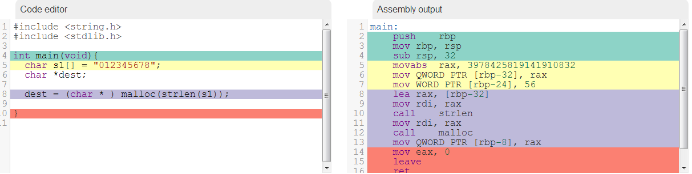
Data Pointers errors (Lets see the difference) The good
mov QWORD PTR [rbp - 8], RAX
This moves 8 bytes (QWORD size) to dest.
dest is at [rbp - 8], and the -8 is simply where it is on the stack relative to the base pointer. (we’ll cover this in detail later)

Slide 45
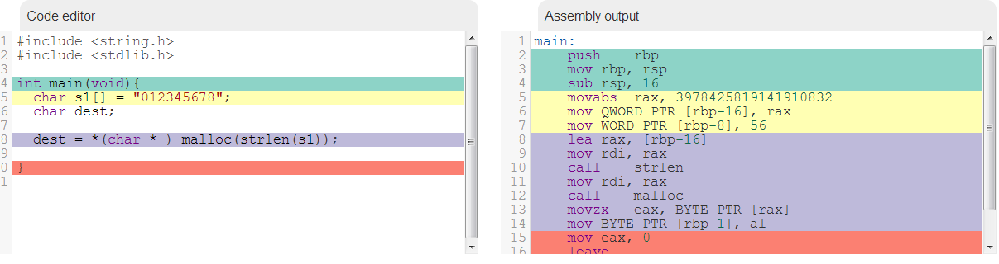
Data Pointers errors (Lets see the difference) The bad
movzx EAX, BYTE PTR [rax]
mov BYTE PTR [rbp - 1], al
This moves 8 bits to dest

Slide 46

Find the bug (60 seconds)
#define MAXCOORDS 5
... void Mapdesc::identify(REAL dest[MAXCOORDS][MAXCOORDS]) { memset(dest, 0, sizeof( dest )); for (int i = 0; i != hcoords; i++) dest[i][i] = 1.0; }
...
This error was found in theReactOSproject by PVS-StudioC/C++ static code analyzer.

Slide 47
Global Offset Table (GOT)
Windows & Linux use a similar technique for linking and transferring control to a library function
linux’s is exploitable
windows’s is safe

Slide 48
Global Offset Table (GOT)
As part of the Executable and Linking Format (ELF), there is a section of the binary called the Global Offset Table
The GOT holds absolute addresses
essential for dynamically linked binaries
every library function used by program has a GOT entry
contains address of the actual function

Slide 49
Global Offset Table (GOT)
Before the first use of a library function, the GOT entry points to the run time linker (RTL)
RTL is called (passed control),
RTL finds function’s real address and inserted into the GOT
Subsequent calls don’t involve RTL

Slide 50
Global Offset Table (GOT)
GOT is located at a fixed address in every ELF
Because RTL modifies it, it is not write-protected
Attackers can write to it
via arbitrary-memory-write vuln
redirect existing function to attacker’s shellcode
learn more with objdump

Slide 51
.dtors Section
only with the GCC compiler. Similar to GOT, contains the destructor function pointer(s).
constructor = .ctors
called before main() is invoked
destructors = .dtors
both segments are writeable by default.

Slide 52

Example Time! (60 Seconds)
int SSL_shutdown(SSL *s) { if (s->handshake_func == 0) { SSLerr(SSL_F_SSL_SHUTDOWN, SSL_R_UNINITIALIZED); return -1; } if ((s != NULL) && !SSL_in_init(s)) return(s->method->ssl_shutdown(s)); else return(1); .... }
This error was found in theOpenSSL project by PVS-Studio C/C++ static code analyzer.

Slide 53

Spot the bug (60 Seconds)
void ClientSession :: findIpAddress(CSCPMessage * request) { .... if (subnet != NULL) { debugPrintf(5, _T("findIpAddress(%s): found subnet %s"), ipAddrText, subnet->Name()); found = subnet->findMacAddress(ipAddr, macAddr); } else { debugPrintf(5, _T("findIpAddress(%s): subnet not found"), ipAddrText, subnet->Name()); } .... }
This error was found in theNetXMS project byPVS-Studio C/C++ static code analyzer.

Slide 54

Last pointer bug (60 seconds)
vdlist_iterator& operator--(int) { vdlist_iterator tmp(*this); mp = mp->mListNodePrev; return tmp; }
This error was found in theVirtualDubproject by PVS-StudioC/C++ static code analyzer.

Slide 55
Dynamic Memory Management
C Memory Management
Common C Memory Management Errors
initialization errors, use-after-free, null dereffs, memory leaks, double free, ...
Doug Lea’s Memory Allocator (next time)
Double Free Vulnerabilities (next time)

Slide 56
C Memory Management (HEAP)
C99 provides 4 memory allocation functions:
malloc(size_t size): allocates size bytes and returns a pointer to the memory address. Memory is not zeroed / initialized
aligned_alloc(size_t alignment, size_t size): allocates size bytes for an object to be aligned by a specific alignment.
realloc(void *p, size_t size): changes the size of the memory pointed to by pointer p to be of size bytes. The contents up to that point will be unchanged. The remainder is attempted to be freed, in which case if is reused without initialization / zeroing may have the old values in place.
calloc(size_t nmemb, size_t size): allocates memory for an array of nmemb elements of size bytes each and returnsa pointer to the allocated memory. Note that memory is set to 0

Slide 57

wat is alignment?
originally a processor design requirement.
Back in the 90’s, On most early unix systems, an attempt to use misaligned data resulted in a bus error, which terminated the program
modern intel (and probably ARM and others) supports the use of misaligned data, it just impacts performance

Slide 58
wat is alignment?
Imagine memory organized (64 bit) like so:
objects lie in neatly aligned byte slots
(lie on a multiple of the object’s size_t value)
byte 0 | byte 1 | byte 2 | byte 3 |  |  |  | byte 7
QWORD A
DWORD B |  |  |  | DWORD C
QWORD D
BYTE E | ?

Slide 59
Another dynamic memory function
alloca() uses the stack for dynamic memory allocation
not C99 or POSIX
but still found in BSD, GCC, and many linux distros
can stack overflow...

Slide 60
Common C Memory Management Errors
Initialization Errors
Failure to check return values
Dereferencing a NULL pointer
Using Freed memory
Multiple frees on same memory
Memory Leaks

Slide 61
Initialization Errors
Failure to initialize
Falsely assuming malloc zeros memory for you
Don’t assume free() zero’s either

Slide 62
Failure to check return values
Memory is limited and can be exhausted
Programmer failure to check return code of malloc, calloc, …
return NULL pointers upon failure
Using null pointer without checking is bad...

Slide 63
Using Freed memory
It is possible to access free’d memory unless ALL pointers to that memory have been set to NULL or invalidated.
Example (from [1] on page 156):
for(p = head; p != NULL; p = p->next)
free(p);

Slide 64
Using Freed memory
Example (from [1] on page 156):
for(p = head; p != NULL; p = p->next)
free(p);
This dereferences p after the first free(p)
free(p);
p = p->next (in the loop)

Slide 65
Using Freed memory
Safer way to do this example:
for (p = head; p != NULL; p = q) {
q = p->next;
free(p);
}
So after the first free(p), it no longer dereferences p:
free(p);
p = q;
q = p-> next;
...

Slide 66
Multiple frees on same memory
Last example tried to free up a linked list:
Not the same as this bug case
a
b
c
d

Slide 67
Multiple frees on same memory
x = malloc(n * sizeof(int));
/* lots of code with accessing x */
/* … */
free(x);
y = malloc(n * sizeof(int));
/* lots of similar (pasted)code with accessing y */
/* … */
free(x);
return; // example from [1] p157

Slide 68
Multiple frees on same memory
Common causes:
cut and paste errors
sloppy error handling
Result:
can corrupt heap memory manager
crash / memory corruption (vulnerability)
memory leakage

Slide 69
Memory Leaks
Failure to free dynamically allocated memory after finished using it.
leads to memory exhaustion
Can be a DoS vulnerability

Slide 70
Memory Allocator
The memory manager on most systems runs as part of the process
linker adds in code to do this
usually provided to linker via OS
OS’s have default memory managers
compilers can override or provide alternatives
Can be statically linked in or dynamically

Slide 71
Memory Allocator
In general requires:
A maintained list of free, available memory
algorithm to allocate a contiguous chunk of n bytes
Best fit method
chunk of size m >= n such that m is smallest available
First fit method
algorithm to deallocate said chunks (free)
return chunk to list, consolidate adjacent used ones.

Slide 72
Memory Allocator
Common optimizations:
Chunk boundary tags
[tag][-----------chunk --------][tag]
tag contains metadata:
size of chunk
next chunk
previous chunk (like a linked list sometimes)

Slide 73
Conclusion Mitigations
Pointers:
_FORTIFY_SOURCE
stack canaries
W^X / NX (More on this later on)
Encoding / Decoding Function pointers

Slide 74
Conclusion Mitigations
String models (From CERT C Secure Coding Standard, by Robert C. Seacord 2008):
Caller Allocates; Caller Frees (C99/OpenBSD/C11)
Callee Allocates; Caller Frees (ISO/IEC TR 24731-2)
Callee Allocates, Callee Frees (C++ std)

Slide 75
Conclusion Mitigations
Dynamic Memory:
NULL-ify pointers after free-ing them. free() does not set the pointer to NULL
ASLR (more on this later)
Testing testing testing
There are tools:
valgrind, insure++, Microsoft’s Application Verifier, IBM’s Purify

Slide 76
Questions?
Reading: 0x260 up to 0x280 (HAOE)

